Slide 1
Stock Trends Prediction System
Team Member and Roll No:
Chaitanya Garg(2210990233)
Bhavika Chopra(2210990221)
Bhavesh Khullar(2210990216)
Bhaumik Luthra(2210990215)

Slide 2
Index
Introduction
Objective
Problem Statement
Methodology, Approach & Techniques
Result
Reference

Slide 3

Introduction
Have you ever wondered how experts predict whether a stock's price will go up or down?
That's where stock trend prediction systems come in! we'll take a closer look at how stock trend prediction systems work, what tools they use, and how they can help you become a better investor.

Slide 4

Objective
The objective of stock trend prediction system is to forecast the future movement of stock prices based on historical data.
Risk Management
Profit Maximization
Decision Support

Slide 5
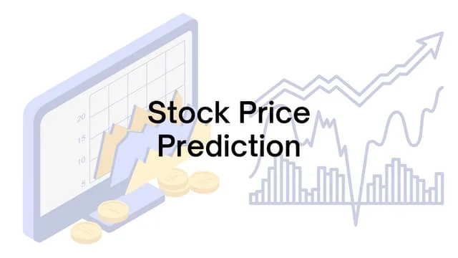
Problem Statement
Developing a stock trend prediction system to accurately forecast future stock price movements amidst complex data, market volatility, and real-time demands. The system aims to provide investors with reliable insights for informed decision-making, addressing challenges in model accuracy, real-time prediction, and risk management.

Slide 6
Methodology, Approach & Techniques
Methodology:
Data Collection and Preprocessing:
Gather historical stock price data and clean it by handling missing values and outliers.
Normalize the data to ensure consistent scales for features.
Feature Engineering and Splitting Data:
Extract relevant features like open, high, low and close prices.
Split the data into training and testing sets, reserving a portion for model evaluation.
Building and Training the LSTM Model:
Define the LSTM architecture with suitable layers, neurons, activation functions, and dropout regularization.
Compile the model with appropriate loss functions (e.g., mean squared error) and optimizers (e.g., Adam).

Slide 7
Methodology, Approach & Techniques
Approach:
Data Preparation and Feature Engineering:
Gather historical stock price data and preprocess it by handling missing values, scaling, and normalization.
Read the dataset from a CSV file using Pandas.
Select relevant features such as open, high, low, close prices, and volume, and possibly incorporate additional technical indicators.
Model Building and Training:
Design and train an LSTM model architecture using the preprocessed data.
Experiment with different LSTM configurations, optimize hyperparameters, and evaluate the model's performance using appropriate evaluation metrics.

Slide 8
Methodology, Approach & Techniques
Techniques:
LSTM Model Architecture:
Employ Long Short-Term Memory (LSTM) networks, known for their capability to capture temporal dependencies in sequential data like stock prices.
Configure the LSTM architecture with suitable hyperparameters and layers to effectively learn from the historical stock price data.
Sequence Data Preparation:
Organize the dataset into input-output pairs, where input sequences represent historical stock prices and output sequences denote future price movements.
Split the dataset into training and testing subsets to train the LSTM model and evaluate its performance accurately

Slide 9
Result
Time and Cost Savings: Automating the prediction process saves investors time and resources.
Continuous Improvement: A robust prediction system is not static; it evolves over time through continuous learning and refinement.

Slide 10
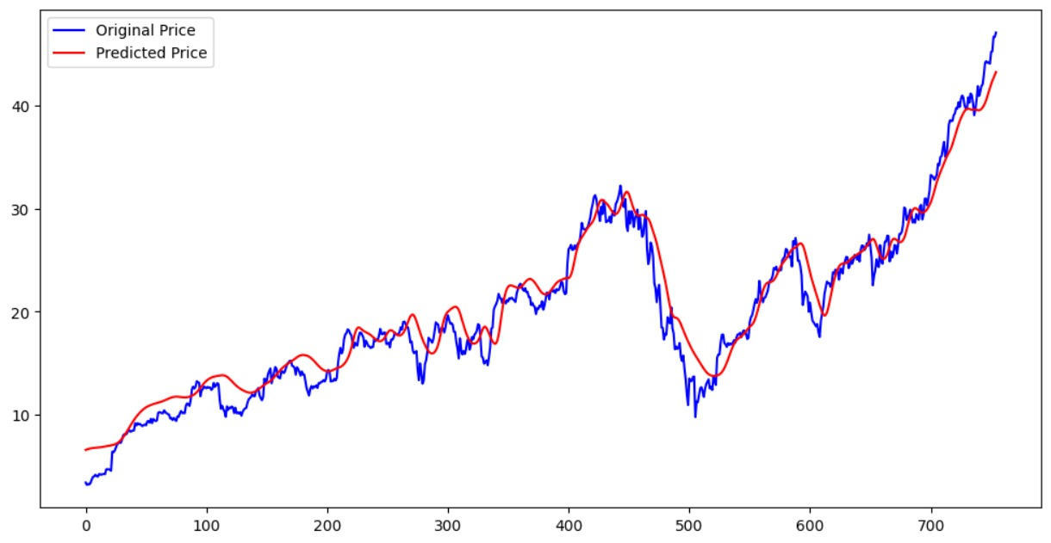
Result

Slide 11
References
https://www.geeksforgeeks.org/
https://www.simplilearn.com/

Slide 12
The End

